Slide 1

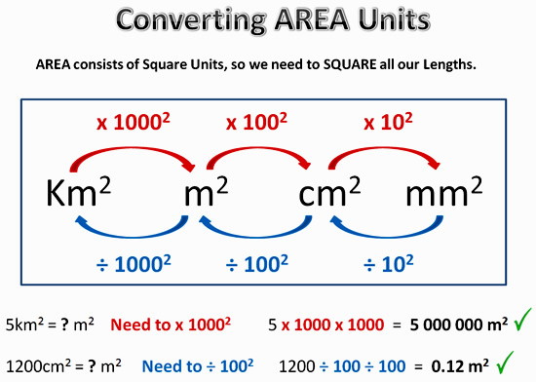
My Measurement Interactive Notebook
Name
Class
Teacher Mr Evans
Term 1 Semester 1
1

Slide 2
Contents
Glossary or Formula Page
Page
Date
Description
2
3

Slide 3
Tasks
24
7
30
Essential Question
Questions
Notes
Summary
6
7

Slide 4
24
7
30
Date
Area
EQ – How do I find the area of composite shapes?
What are composite shapes?
Compound shape: a 2D shape made up of many shapes
How do we find the area of composite shapes?
5

Slide 5
24
7
30
Date
Area
EQ – How do I find the area of composite shapes?
How do we find the area of composite shapes?
To find the area of compound shapes, split them up into their composite shapes.
Find the area of each shape, then add them together
5

Slide 6
I Do
8cm
Area A = 8 x 5
= 40cm²
A
5cm
Area B = 11 x 2
= 22cm²
B
11cm
Total Area = 40 + 22
= 62cm²
2cm

Slide 7
We Do

Slide 8
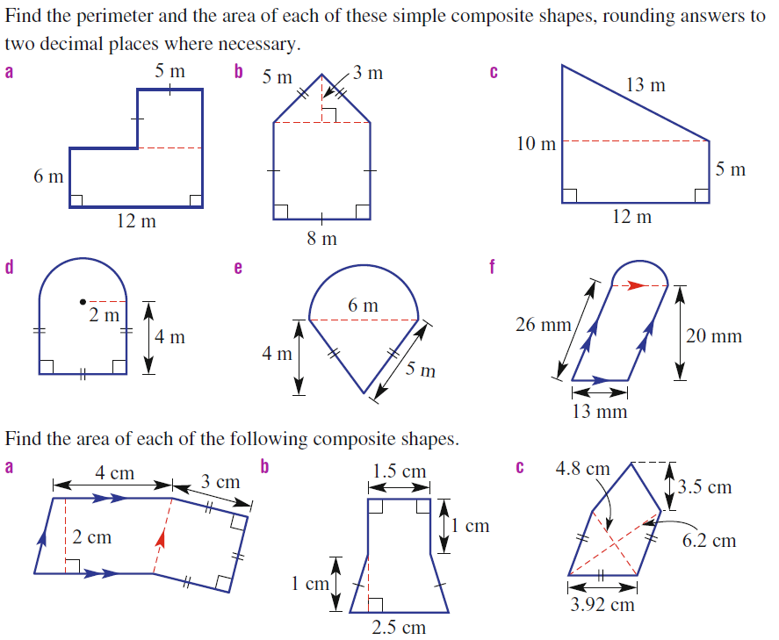
You Do

Slide 9
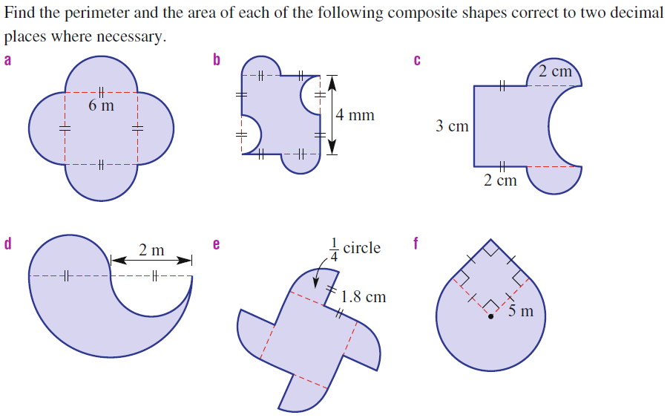
Questions

Slide 10
Notes Review
24, 7 ,30
Date
Title
Essential question
Notes complete
Notes complete with colour and diagrams
Questions completed
Contents page filled in
Formula page filled in

Slide 11
Homework
Review your notes and write a summary answering the essential question.

